Slide 1
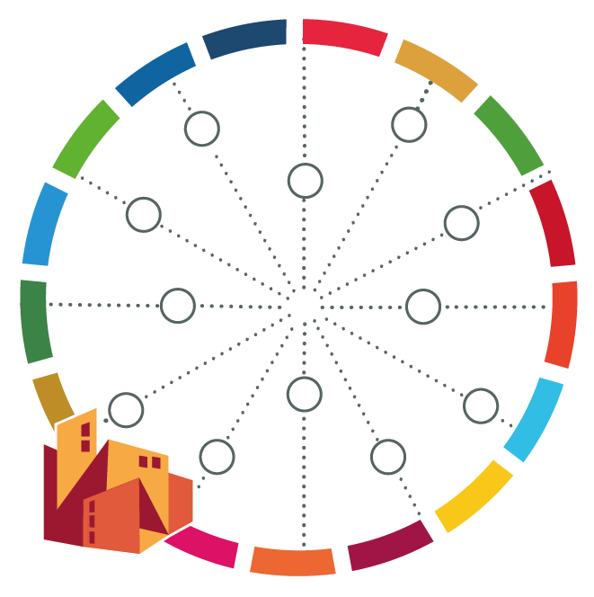
CityWorks: Video Collection
(You can find further information in the notes below the slides)

Slide 2
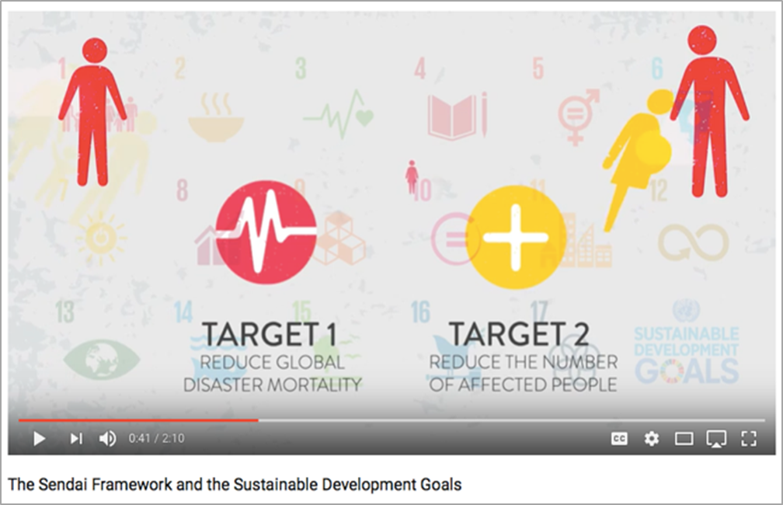
Notes:
The Sendai Framework and the Sustainable Development Goals
https://www.youtube.com/watch?v=N6soXnTsgZg
The Sendai Framework for Disaster Risk Reduction, adopted in March 2015, was the first of four agreements approved by the international community in 2015 with the overall aim of making development more sustainable in the face of a raft of challenges faced by the world. This video explains how the Sendai Framework interlinks with the Sustainable Development Goals, which were adopted in September 2015. You can find out more here about the connections between the international efforts to reduce disaster risk and those to make development sustainable: http://www.unisdr.org/we/advocate/sus..
UNISDR My City is Getting Ready: 10 essentials for cities
• Targeting mayors and city governments
• Providing partner support, investment-cooperation opportunities, local action planning, monitoring
• Champions and toolkits

