Slide 1
1. Define strategic goals and operational targets for each relevant sector (government and comunity sectors) - Template 1. A
Sector | Strategic goal | Operational targets
Buildings and Facilities
Vehicle Fleet
Street lighting
Water and wastewater
Waste
Other
Residential
Commercial
Industrial
Transportation
Other
Sectors can also differ according to other given structures

Slide 2
1. Define strategic goals and operational targets for each relevant sector (government and comunity sectors) - Template 1. B
Priority climate impact | Sector affected | Strategic goal | Operational targets
Sectors can also differ according to other given structures

Slide 3
2. Assess mitigation and adaptation policies and measures for government operations (Template 2.A)
Sector | Key mitigation technologies and practices currently available | Policies, measures and instruments shown to be effective | Key constraints (-) or opportunities (+) | Key adaptation technologies and practices currently available | Policies, measures and instruments shown to be effective | Key constraints (-) or opportunities (+) | Links and synergies between mitigation and adaptation
Buildings and Facilities
Vehicle Fleet
Street lighting
Water and wastewater
Waste
Other

Slide 4
2. Assess mitigation and adaptation policies and measures for community operations (Template 2.B)
Sector | Key mitigation technologies and practices currently available | Policies, measures and instruments shown to be effective | Key constraints (-) or opportunities (+) | Key adaptation technologies and practices currently available | Policies, measures and instruments shown to be effective | Key constraints (-) or opportunities (+) | Links and synergies between mitigation and adaptation technologies, policies, measures and instruments
Residential
Commercial
Industrial
Transportation
Agriculture
Waste
Other

Slide 5
3. Identify actions to manage greenhouse gas emissions (government and community) – Template 3.A
Sector | Sector Strategy | Target | What actions will be implemented | How will the actions be implemented | Who is responsible for implementing actions | What is the timeframe | Priority/ Budget
Buildings and Facilities
Vehicle Fleet
Street lighting
Water and wastewater
Waste
Other
Residential
Commercial
Industrial
Transportation
Other
Notes:
Directions
Present workshop participants with an overview of the priority sectors and priority climate impacts
Present staff suggestions, ‘entry points’ or opportunities identified in the priority sectors and for priority impacts as part the Phase 1 and Phase 2 tools.
Present the strategies and targets identified as they relate to specific sectors or priority climate impact.
Organise the participants into small groups.
Ask workshop participants to consider these suggestions and to brainstorm actions in the priority sectors and for priority impacts, as they relate to the strategies and targets identified.
Workshop participants should enter their results into the tables below (which should be modified to include only the priority sectors and priority impacts).
For each action that is prioritized, the workshop participants must discuss and decide how the action should be implemented, identify the department responsible for implementation, rank the priority of the action, and identify a timeframe for implementation.
Collect all pieces of paper and record all actions identified
Experience shows that city staff are reluctant to commit others to tasks, and so for this reason, the Climate Action Taskforce must commit to engaging relevant departments after the workshop to get their buy-in and support.
The Climate Action Taskforce can write the final action developed as part of the workshop and refined through consultation with relevant departments.

Slide 6
3. Identify actions to to respond to priority climate impacts – Template 3.B
Climate Impact | Target Condition | Sectors Affected | Strategy | What actions will be implemented | How will the actions be implemented | Who is responsible for implementing actions | What is the timeframe | Priority/ Budget

Slide 7
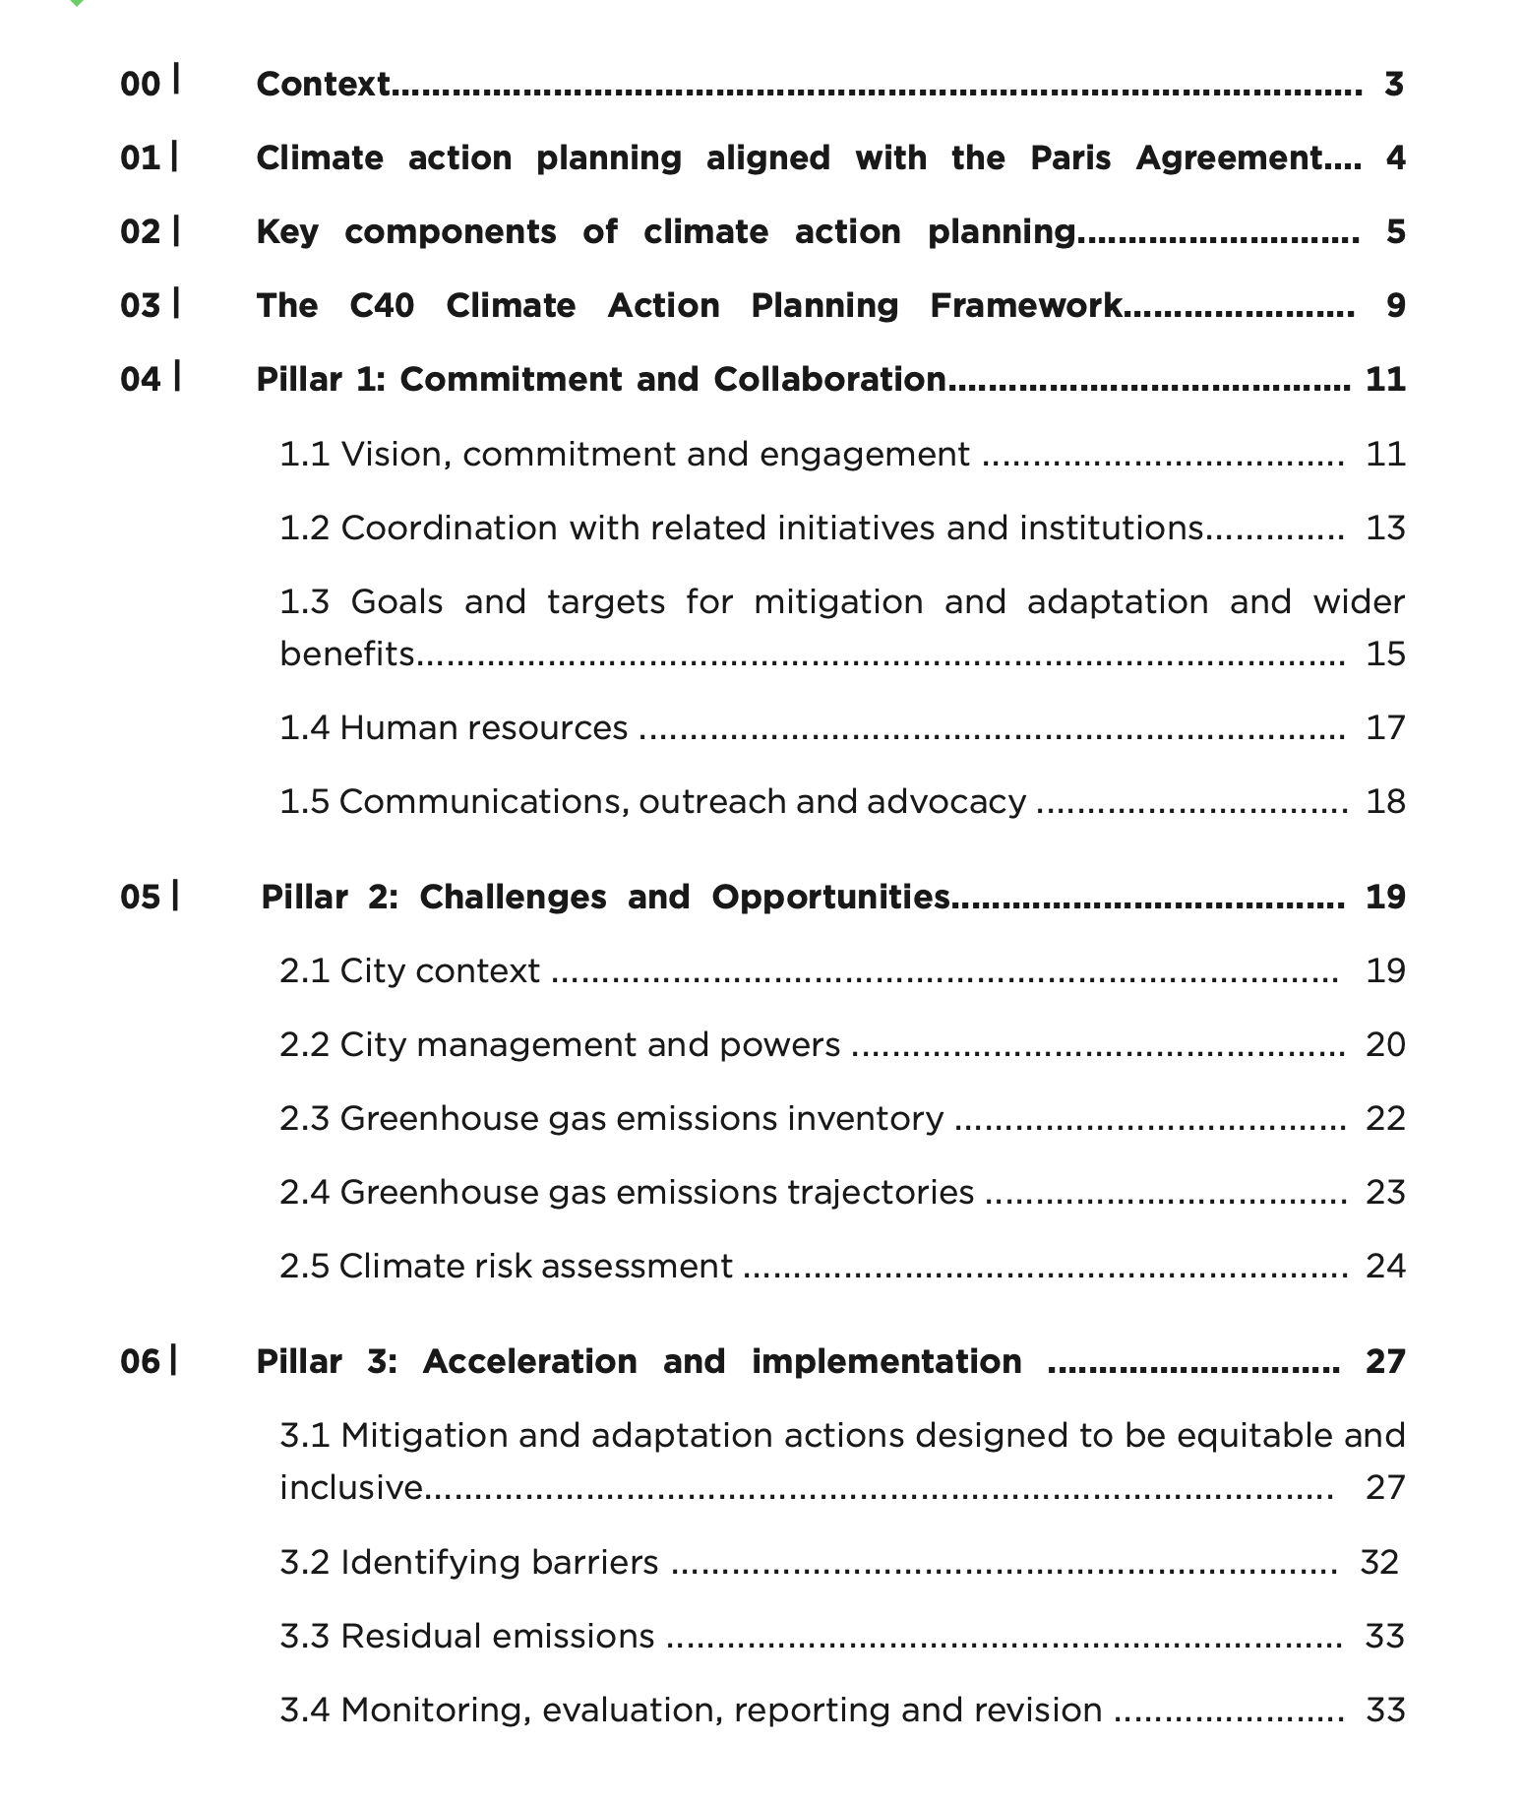
C40 – Climate Action Planning Framework
https://cdn.locomotive.works/sites/5ab410c8a2f42204838f797e/pages/5ae2f92374c4837e195d0e00/files/20200324_C40_Climate_Action_Planning_Framework.pdf?1620380307

Slide 8
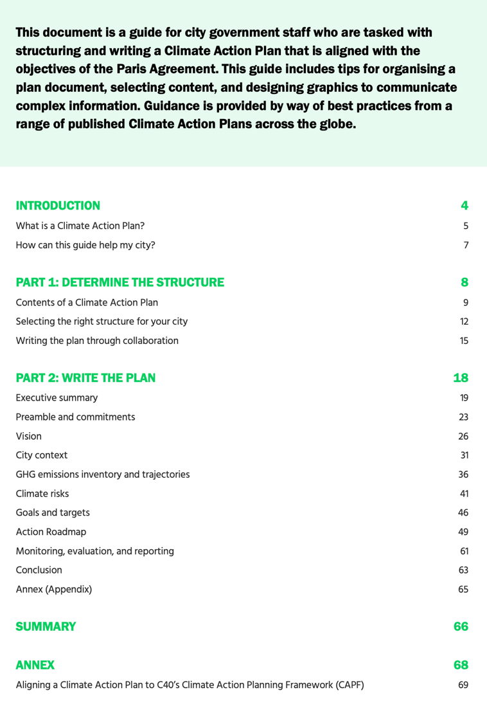
C40 – Guide to structuring and writing a Climate Action plan
https://cdn.locomotive.works/sites/5ab410c8a2f42204838f797e/content_entry5ab410fb74c4833febe6c81a/6011fb0b2d5f3d00a53803ee/files/C40_CAP_Guide_20210128.pdf?1613752858

Slide 9
Climate Action Plan – Key Components
Source: Guide to structuring and writing a Climate Action plan
Notes:
https://cdn.locomotive.works/sites/5ab410c8a2f42204838f797e/content_entry5ab410fb74c4833febe6c81a/6011fb0b2d5f3d00a53803ee/files/C40_CAP_Guide_20210128.pdf?1613752858

Slide 10
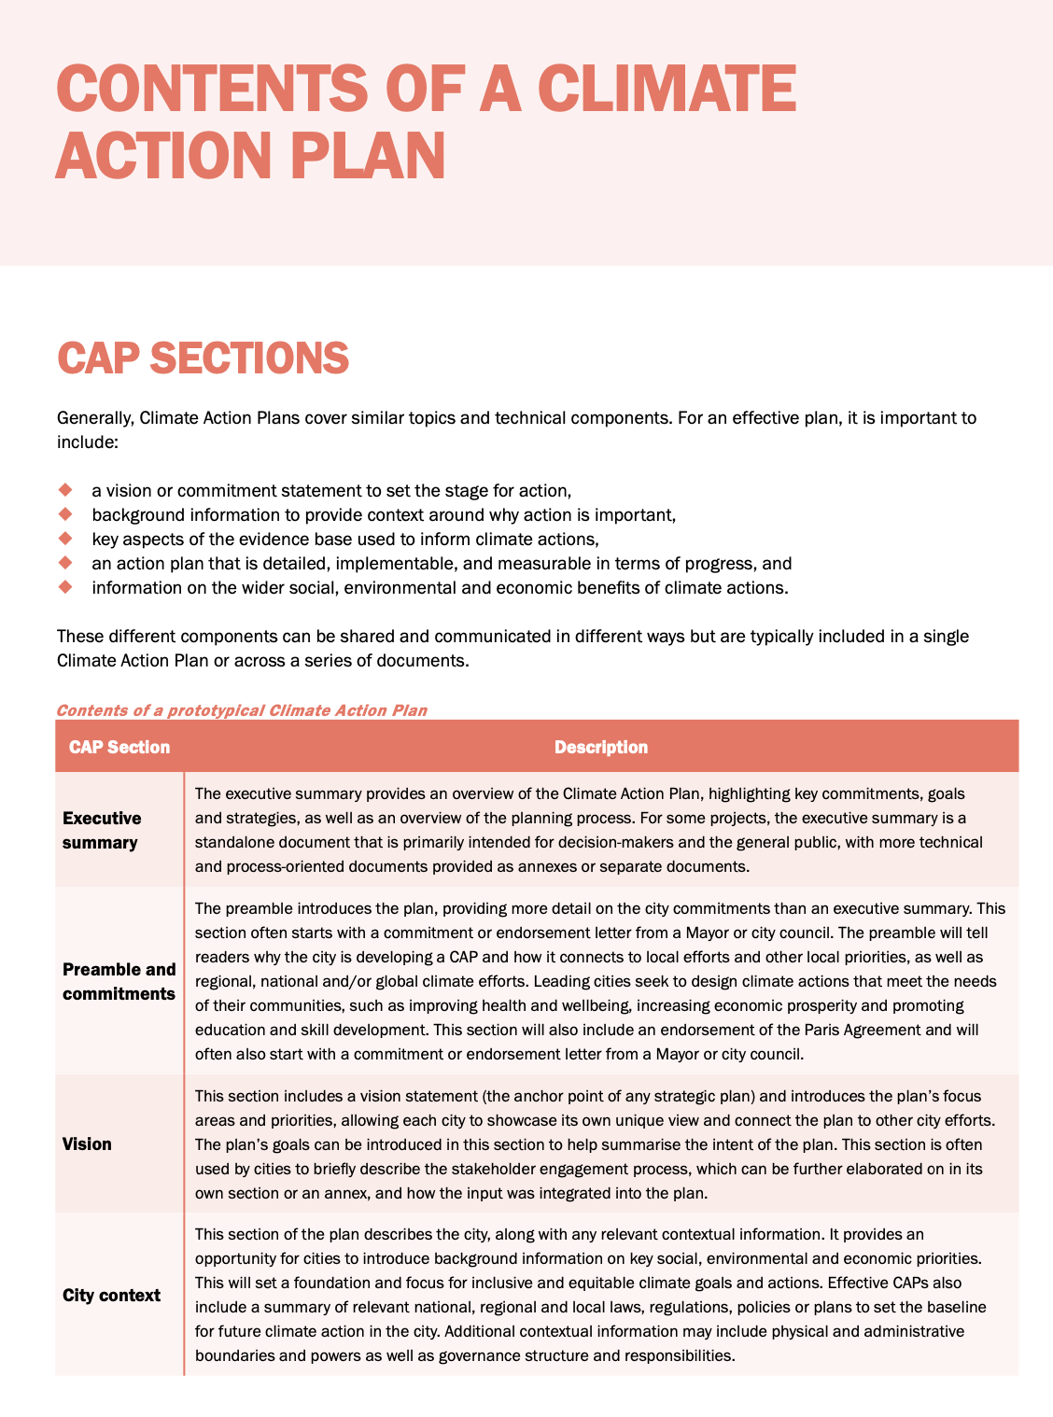
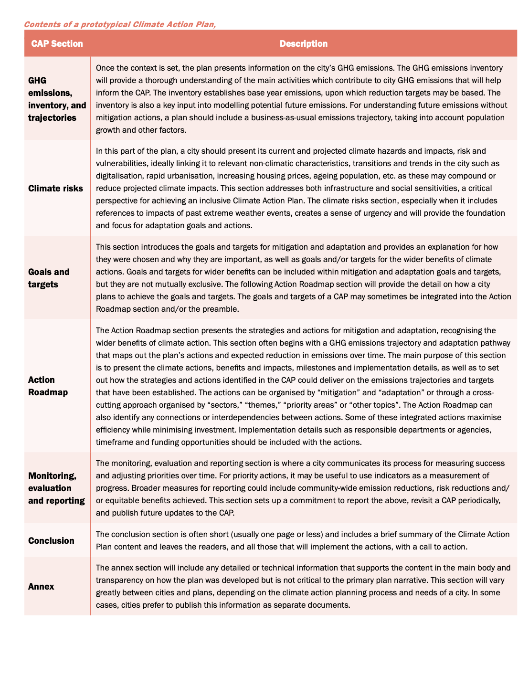
Source: Guide to structuring and writing a Climate Action plan

